Slide 1
Urban Air Pollution Machine Learning Project
Rachel Kwon, Winston Tang

Slide 2
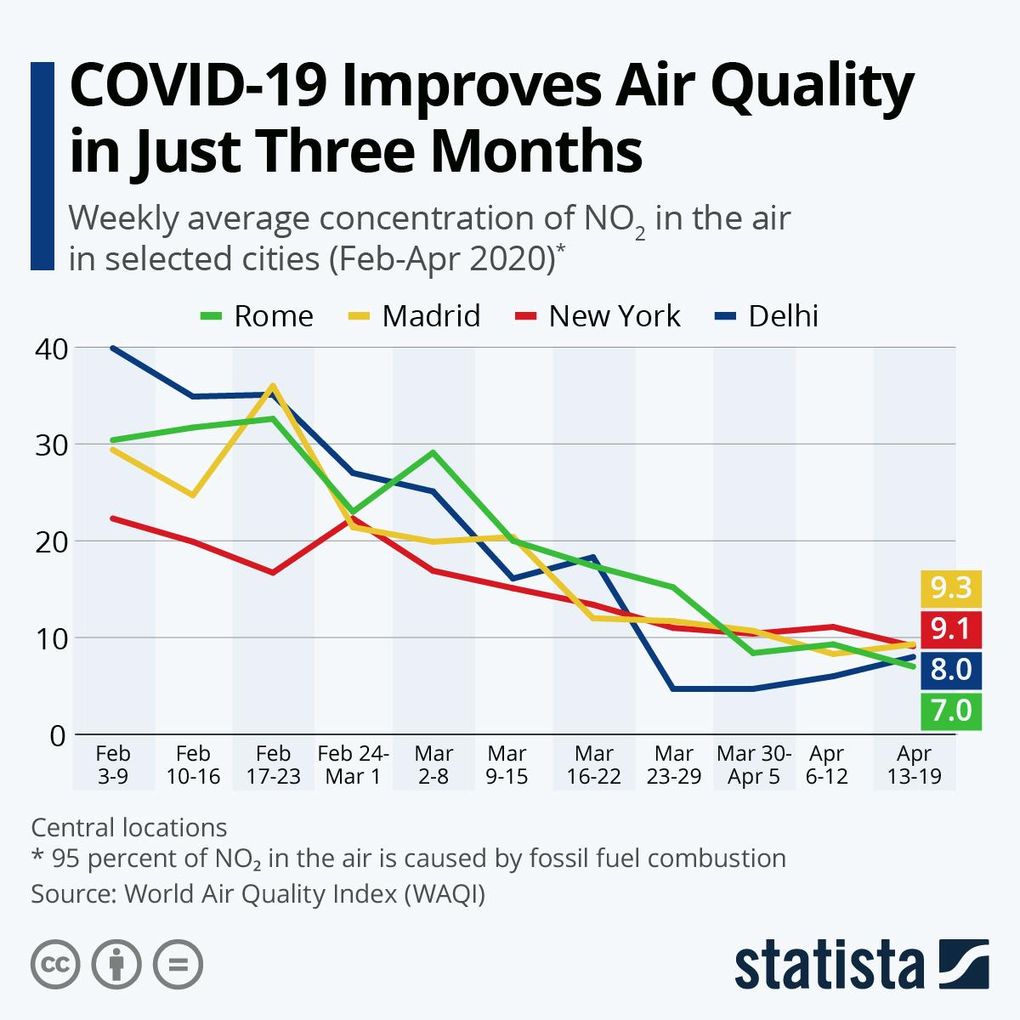
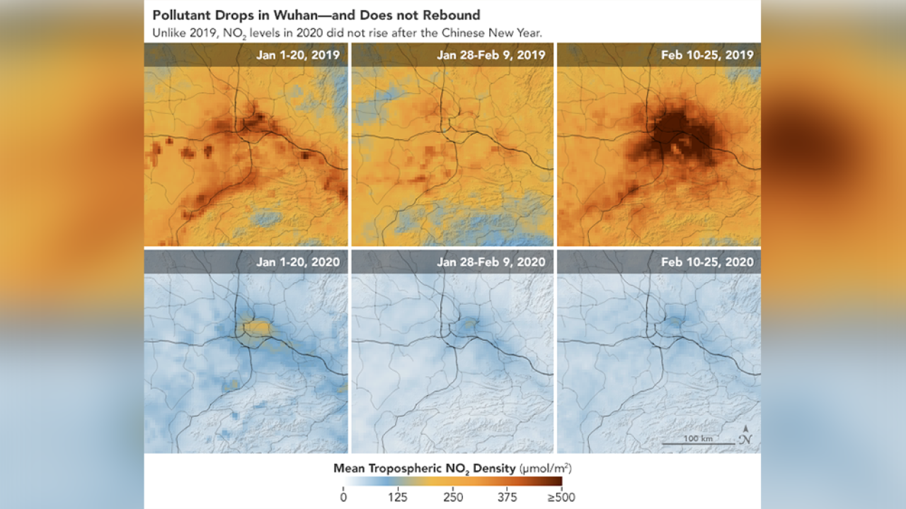
COVID-19 and the Environment
In the midst of a devastating global pandemic people have been searching for glimpses of positivity
One such idea is that nature is “healing” due to decreased human activity
Particularly that COVID-19 has led to cleaner air
Notes:
Not True in many African cities...

Slide 3
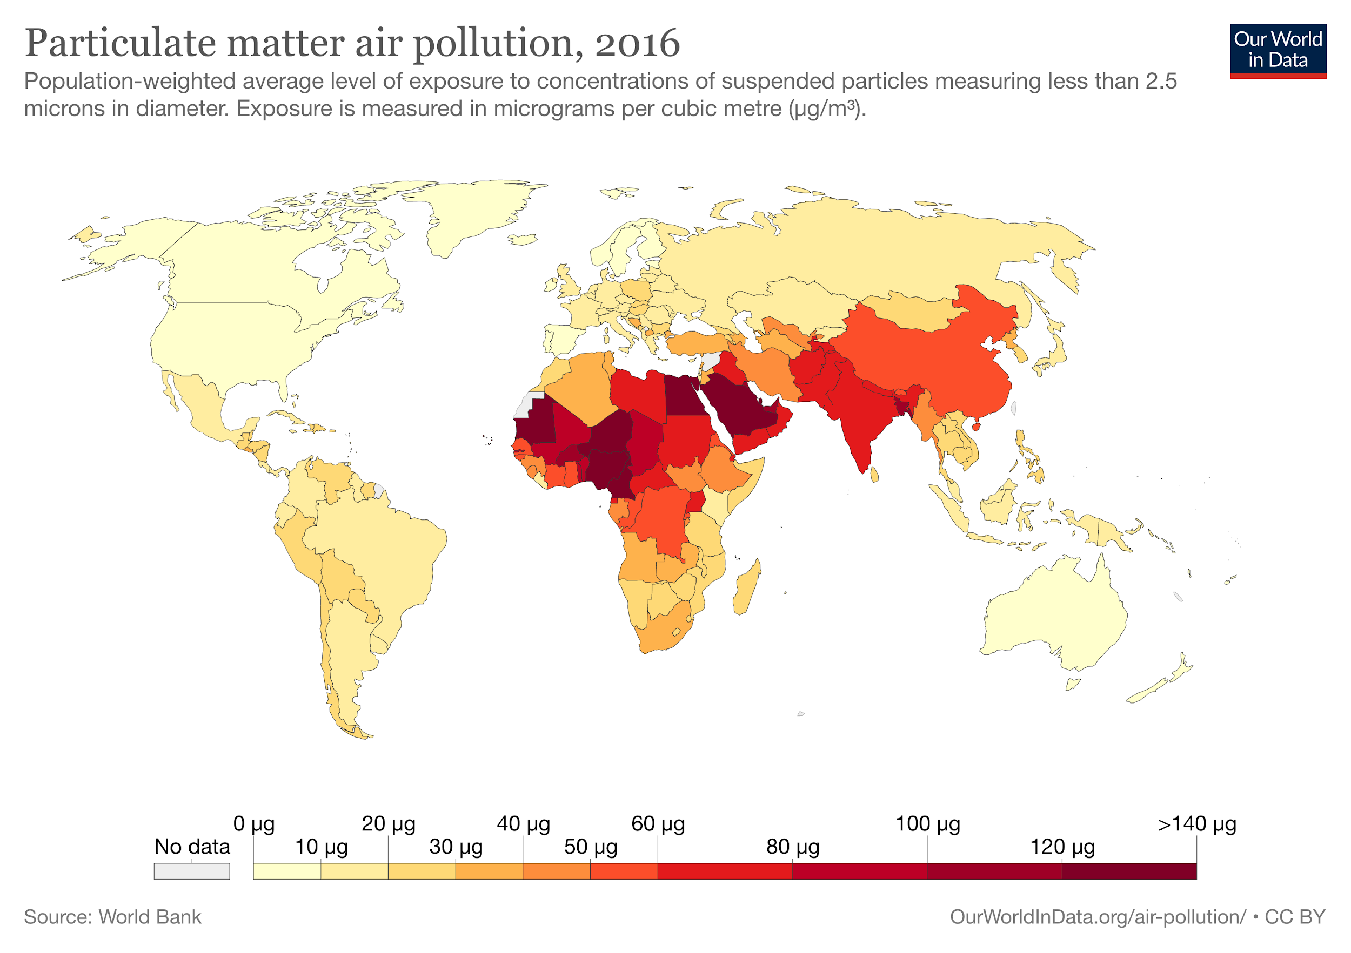
Air Pollution in Africa
Most statistics speak of NO2 concentrations, however, the most harmful air pollutants are particulates known as PM2.5 which can enter the lungs and bloodstream
We can see that Africa has had alarmingly high rates of PM2.5 concentration
During COVID-19, air pollution in African cities is worsening as people stay home
This is a serious problem in the long run and in the present as poor air quality can make respiratory illnesses more severe

Slide 4
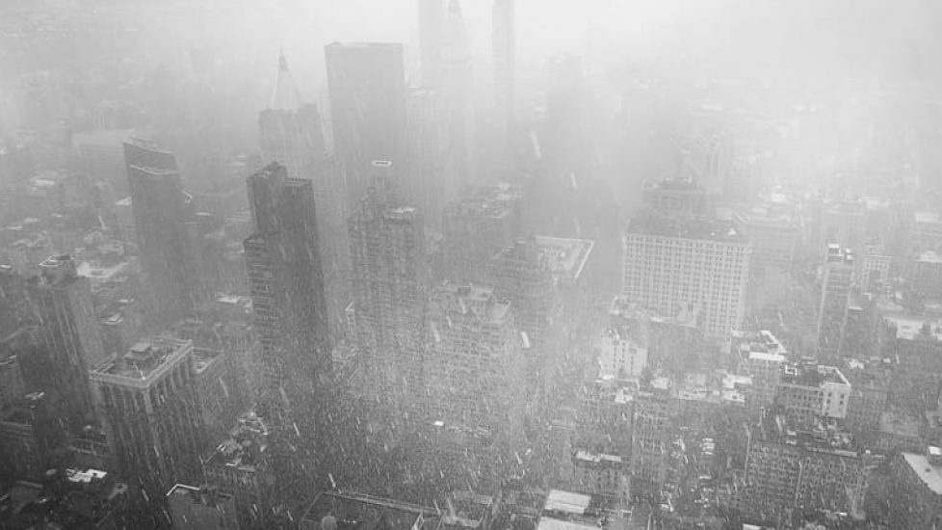
Problem & Task
Problem: PM2.5 concentration is measured by ground-based sensors but not all cities in Africa have these sensors
Task: Use weather data and daily observations from the Sentinel 5P satellite tracking various pollutants in the atmosphere to predict PM2.5 every day for each city

Slide 5
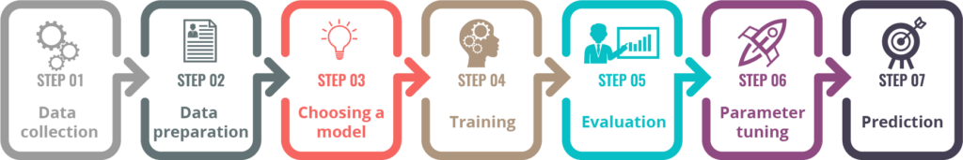
Data Collection
Weather data provided by Global Forecast System: humidity, temperature, precipitation, etc
Sentinel 5P satellite measures various pollutants in the atmosphere: NO2, SO2, CH4, etc
Data Preparation
Dealing with missing values
Creation of datetime columns: months, weeks, days

Slide 6
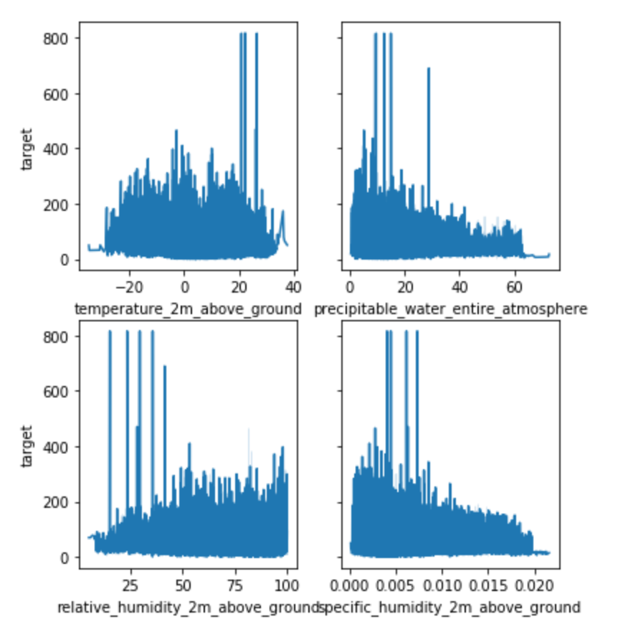
Insight with Outliers
The outliers with very high PM2.5 concentrations (~800) seem to be in areas of high temperature, low precipitation and humidity.
The data roughly follows this trend as well
Possibly the most dry and arid regions of Africa

Slide 7
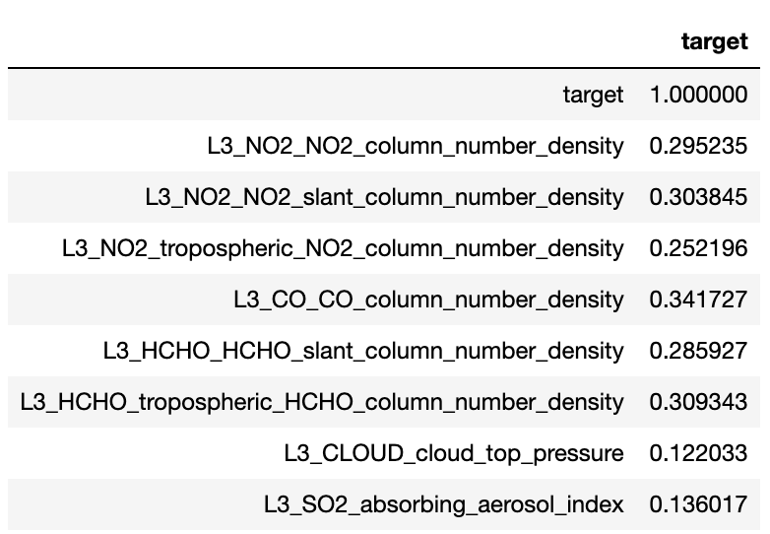
Feature Selection
Initially 82 columns
Correlation / Multicollinearity Analysis between ‘Target’ (PM2.5) and other variables
Also ran RandomForestRegressor to get top 20 most important features
Combined features from those 2 analyses together to reduce to 20 columns

Slide 8
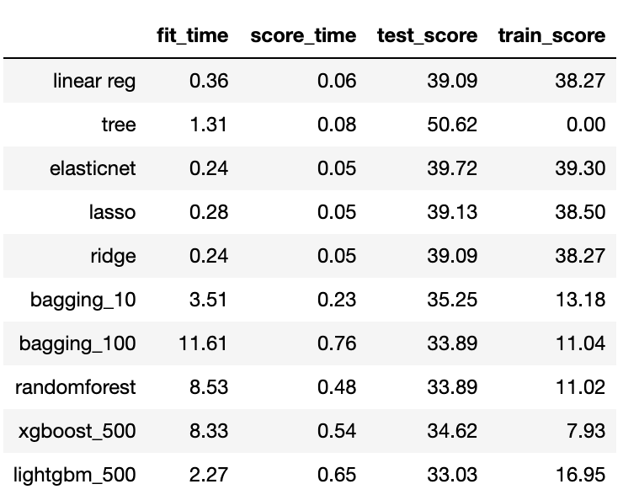
Prediction Models
We used cross validation to evaluate different models and the RMSEs of their errors in predictions — the lower the score, the better the prediction is.
According to the scores, the xgboost and lightgbm models yield the best results. So we picked these two models for our prediction.

Slide 9
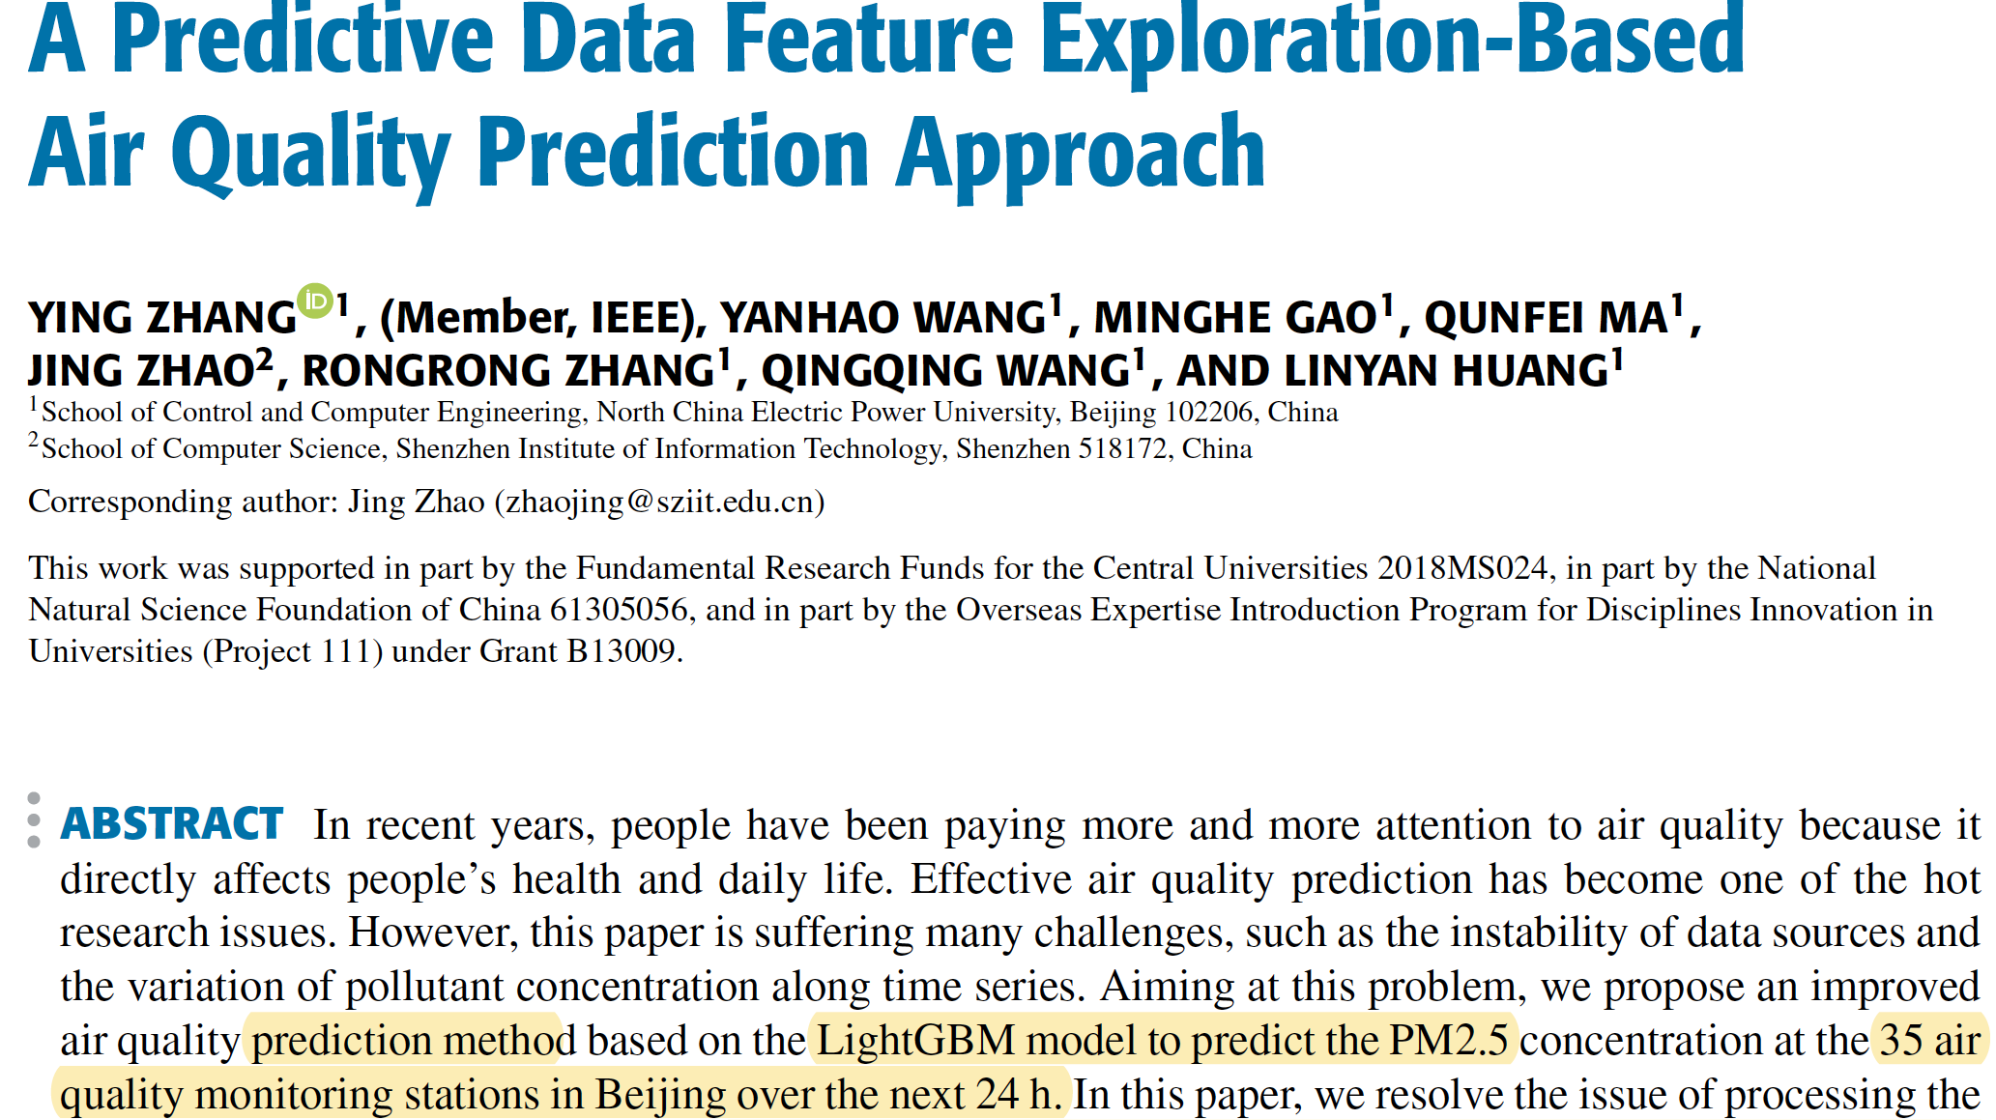
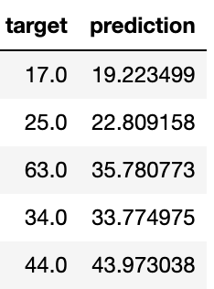
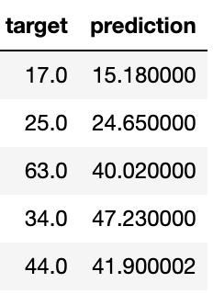
Prediction Result
With a few exceptions, both models produced predictions that are within close range with the real values.
We ultimately picked Lightgbm model due to current research which indicates that such a model leads to more accuracy.
LightGBM
XGBoost

Slide 10

Recommendations
Local and international environmental agencies should pay closer attention to the air quality in major urban areas — people staying at home and less traffic do not equate to less air pollution
Researchers can look into the reasons behind changes in air pollution during the COVID-era and leave the implications for further studies in environmental protection and public health policies in the future
Confirmed: greenhouse gases densities are directly correlated to PM2.5 values

Slide 11

Q&A Time
Thank you!

